Slide 1
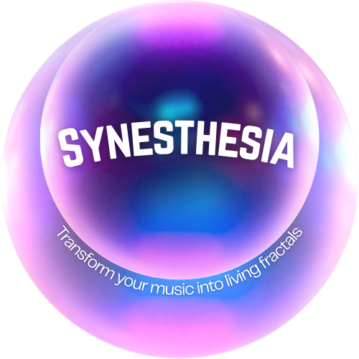
Căpitanu Andreea
Dogăreci Bianca-Alexandra
Ionaşcu Dragoş-Adrian
Diţoiu Andrei-Adelin

Slide 2
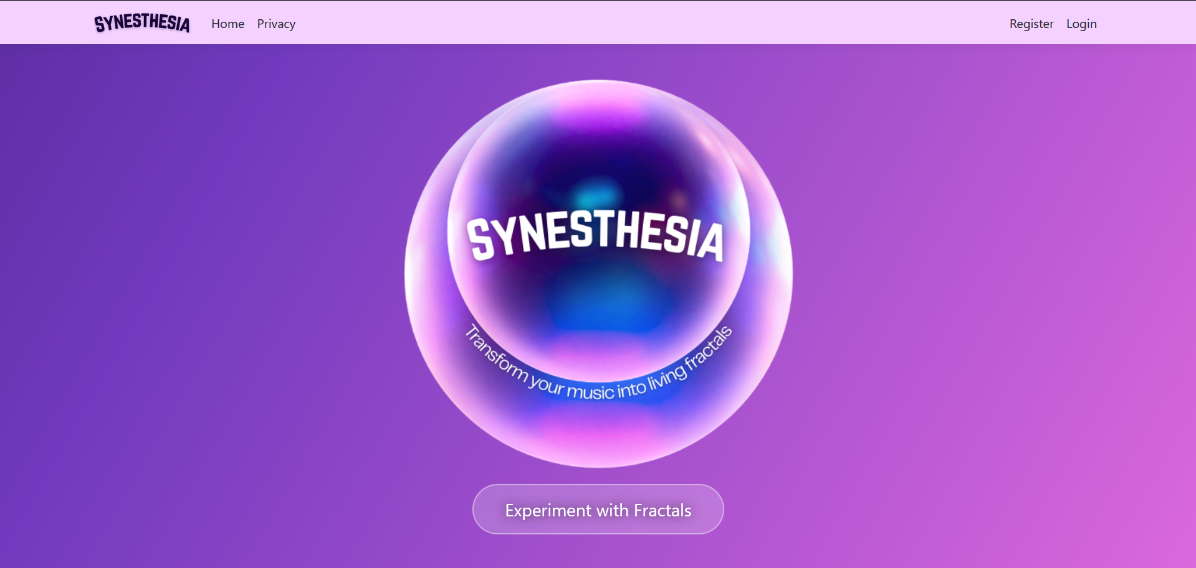

Slide 3
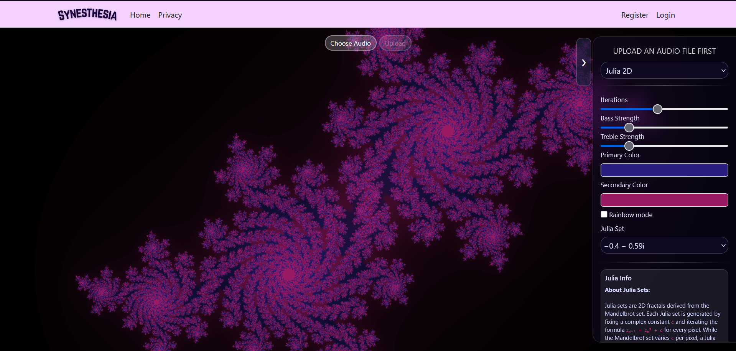

Slide 4
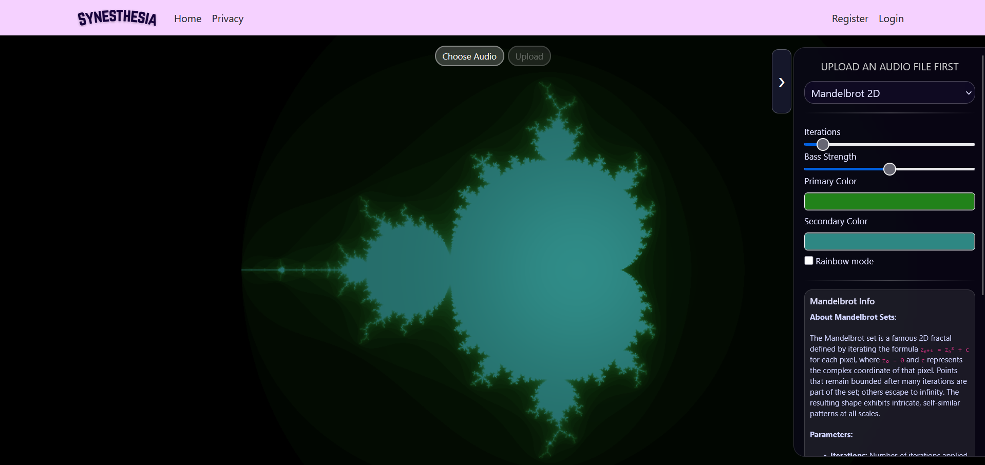

Slide 5
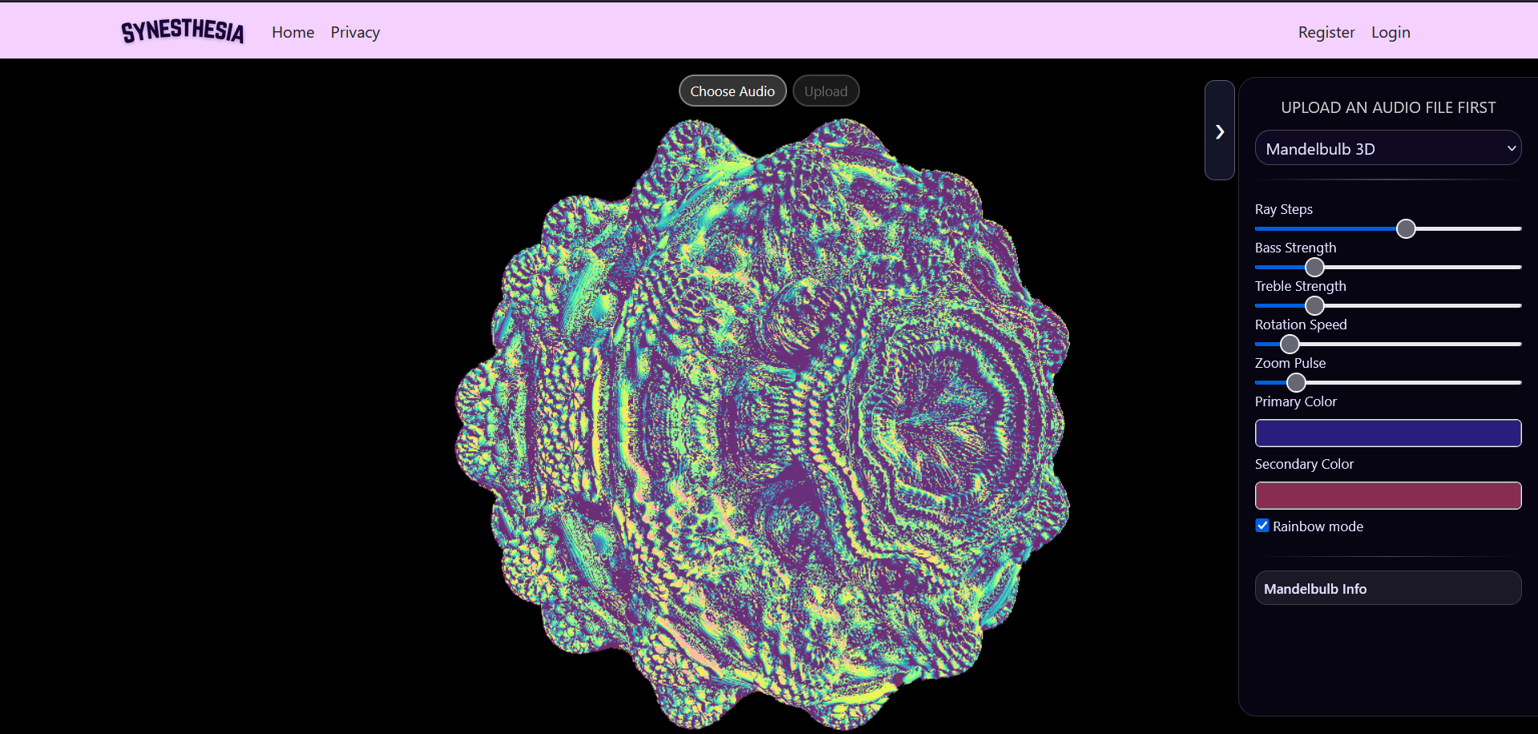

Slide 6
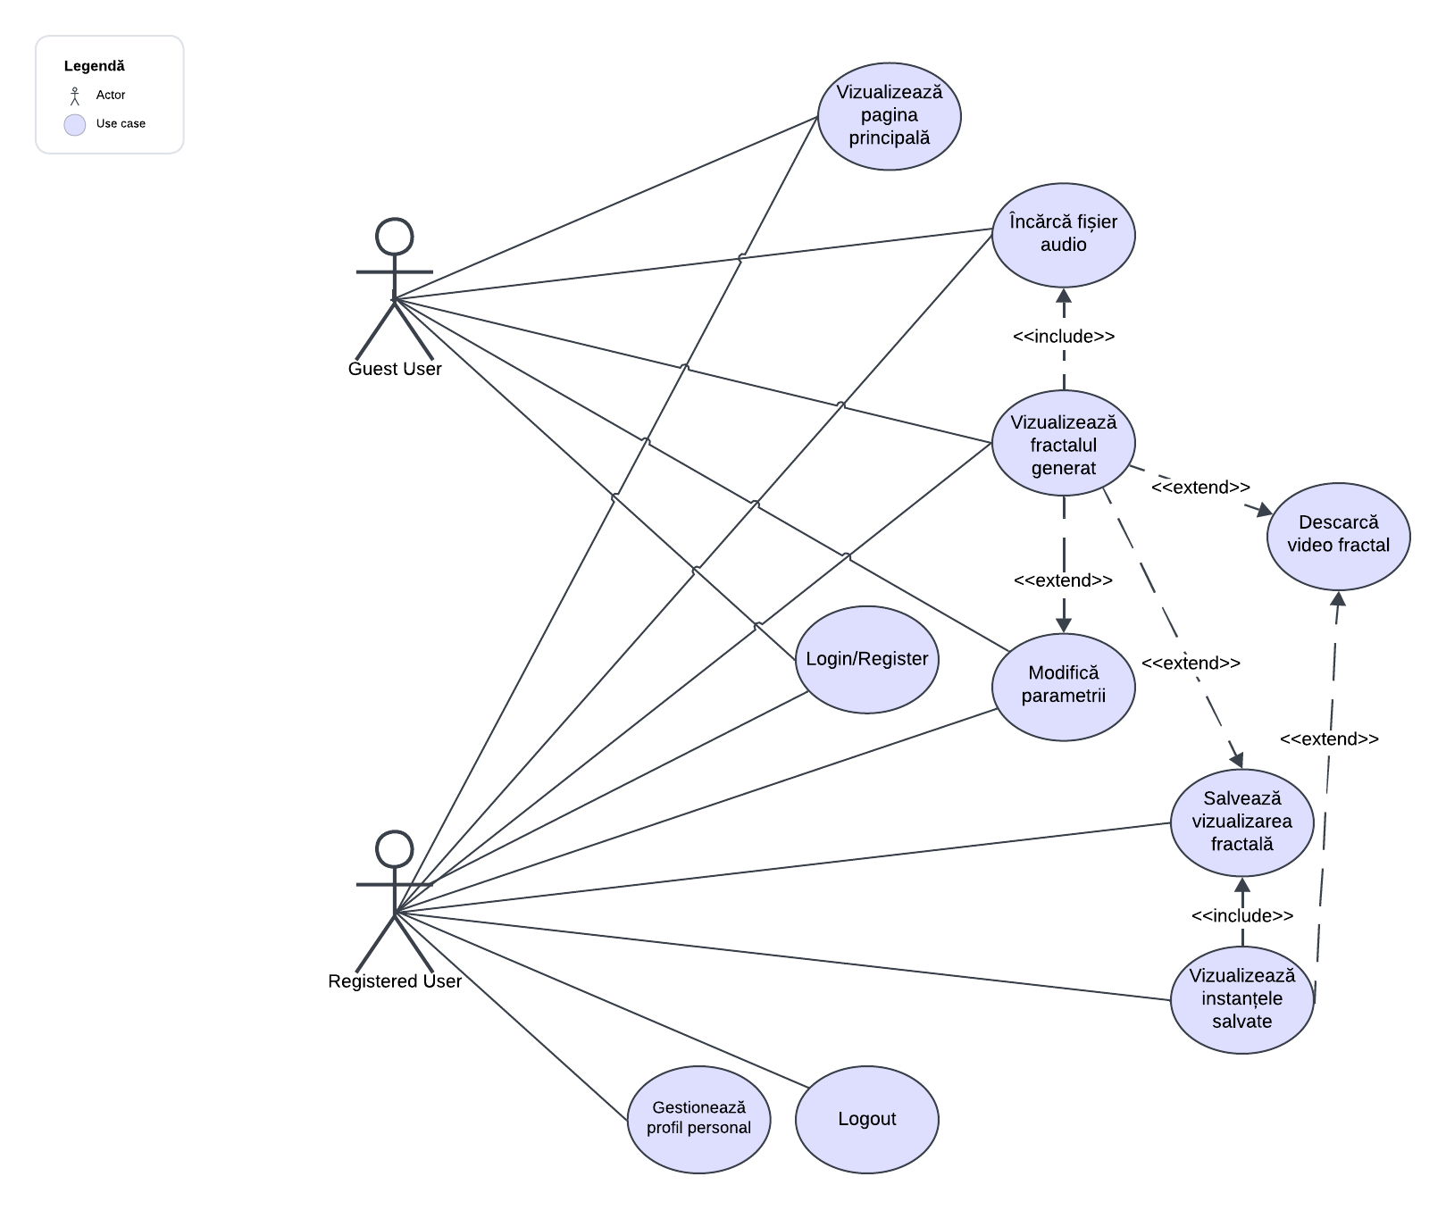
Use Case Diagram

Slide 7




Test-Driven Development
Pair Programming

Slide 8
Test-Driven Development
Follow Red → Green → Refactor
PROS
Helped clarify expected behavior early
Safer refactoring because existing tests immediately detected mistakes
CONS
TDD was only applied to C# backend logic
Difficult for complex JavaScript logic
Fractal logic evolved frequently, making early tests unstable or irrelevant

Slide 9
Pair Programming
Roles: Driver & Navigator
PROS
Useful when working with complex logic
Instant feedback
Knowledge sharing
Easier to continue work when one person is stuck
When requirements evolved during development
CONS
Effectiveness strongly depends on the compatibility of the two developers
Requires good communication and similar coding styles or architectural visions

Slide 10
Pragmatic approach: testing strategy adapted to the nature of each technology.

Slide 11
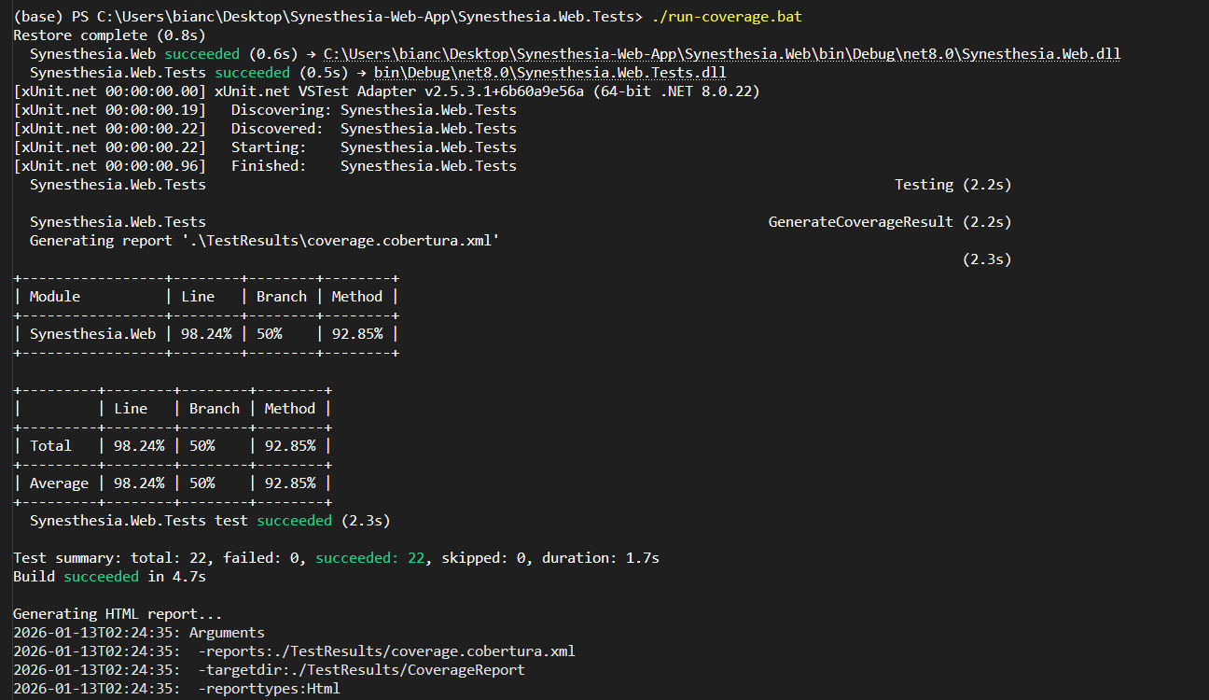
Test Coverage

Slide 12
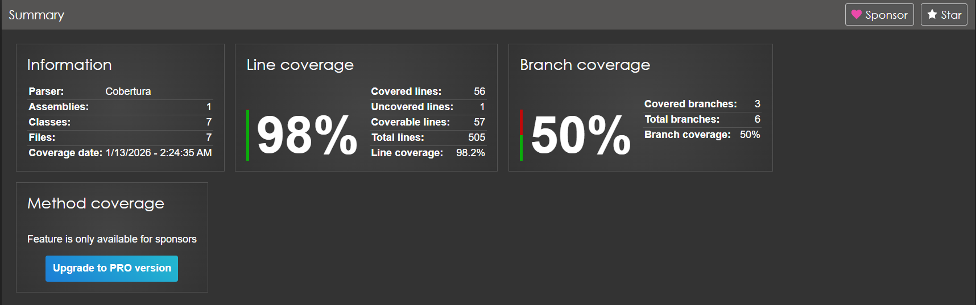
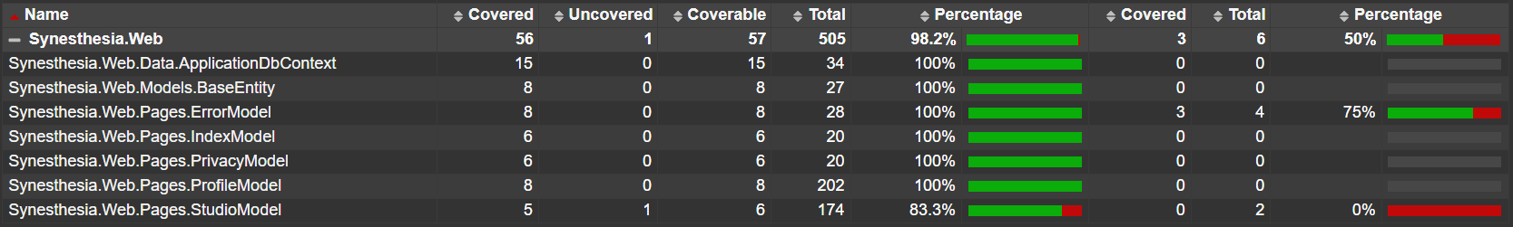
Test Coverage

Slide 13
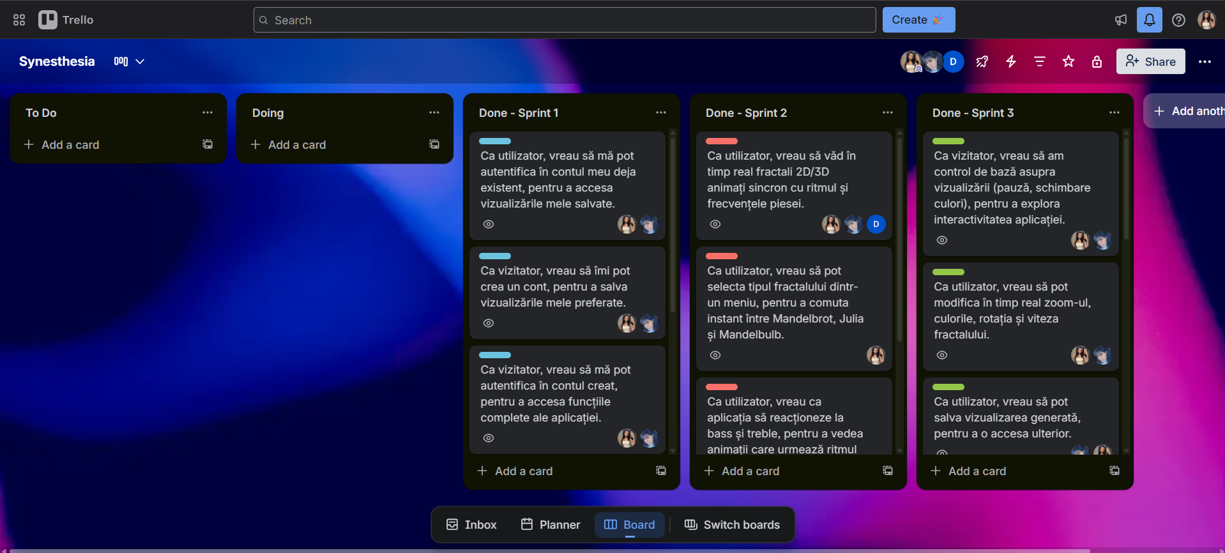
Project Management and Issue Tracking

Slide 14

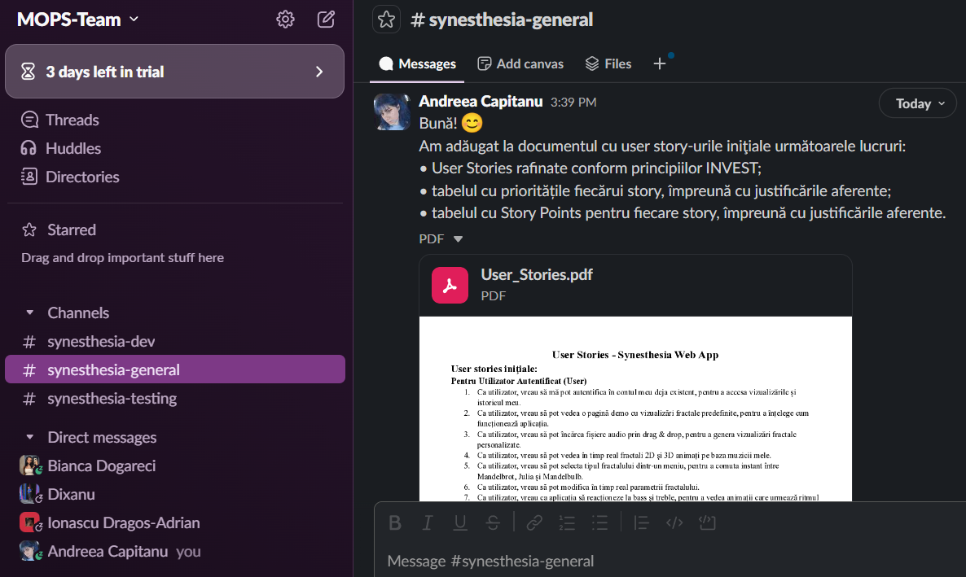
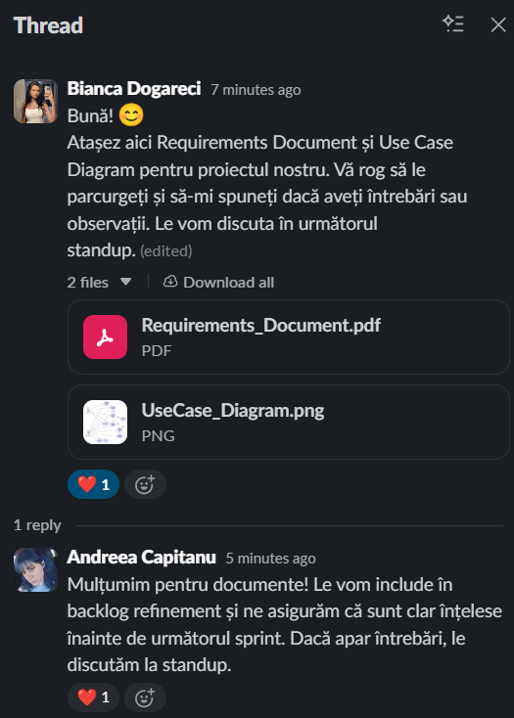

Communication
-> sharing docs etc.
-> pair programming, meetings etc.

Slide 15
Impediments
01
02
03
Code coverage tool including files like: migrations, ApplicationDbContext.cs etc.
Making fractal parameters change with music, not the viewport/camera
Recording video at a higher quality

Slide 16


Version Control & Collaboration
Link to our GitHub repository!

Slide 17
Contribution of each member
Căpitanu Andreea - 35%
Dogăreci Bianca-Alexandra - 35%
Ionaşcu Dragoş-Adrian - 20%
Diţoiu Andrei-Adelin - 10%

Slide 18
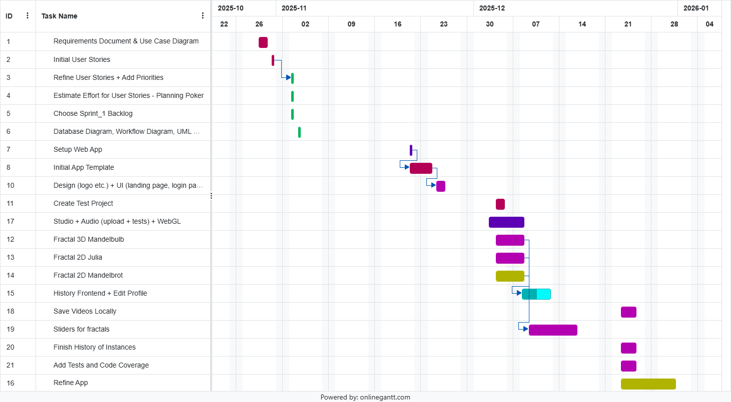

Slide 19
Thank you!

